Slide 1
Temporal patterns

Slide 2
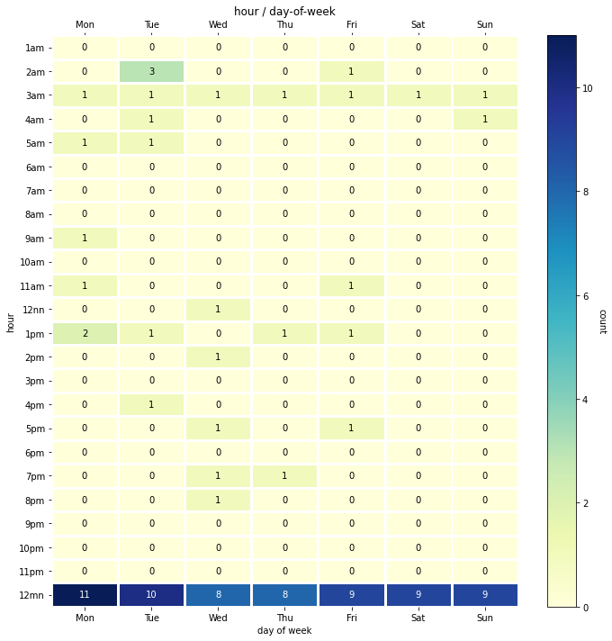
Plot of events per hour

Slide 3
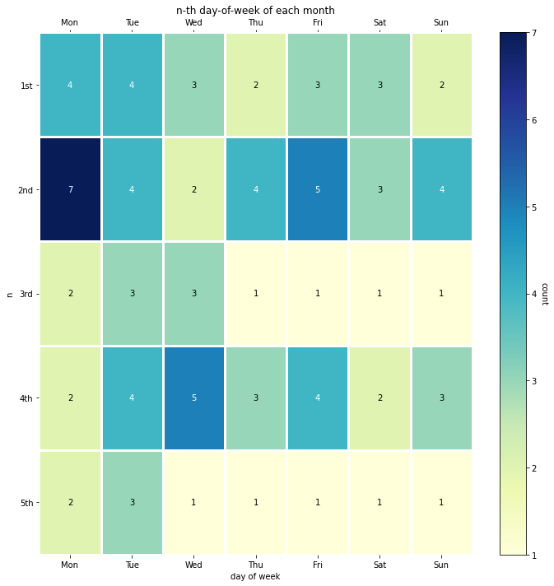
Plot of events per day-of-week

Slide 4
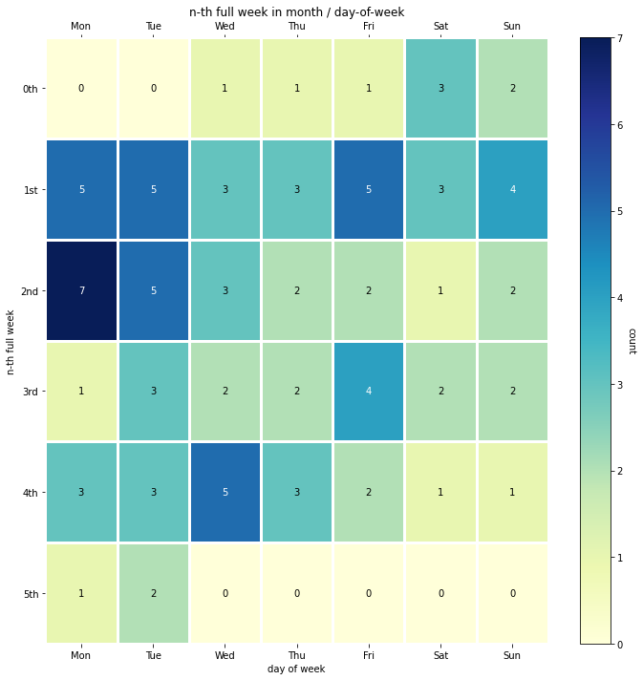
Plot of events per day-of-week

Slide 5
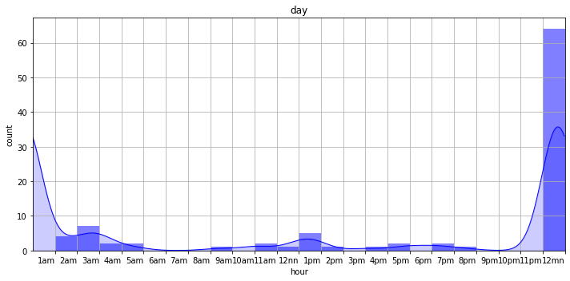
Histogram of events per hour

Slide 6
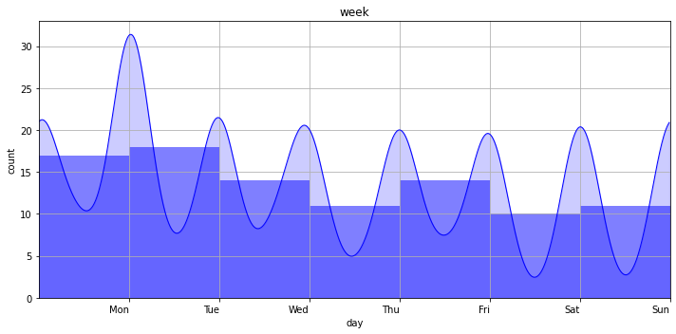
Histogram of events per day-of-week

Slide 7
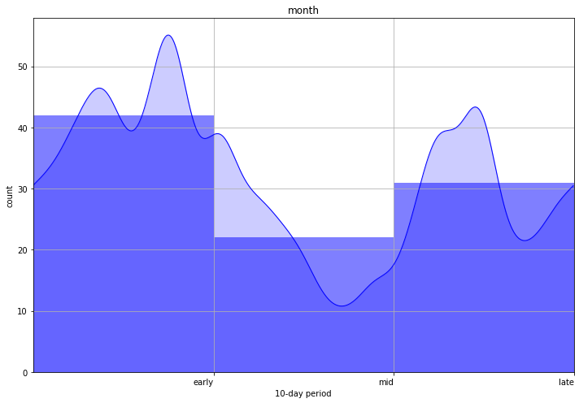
Histogram of events over a month

Slide 8
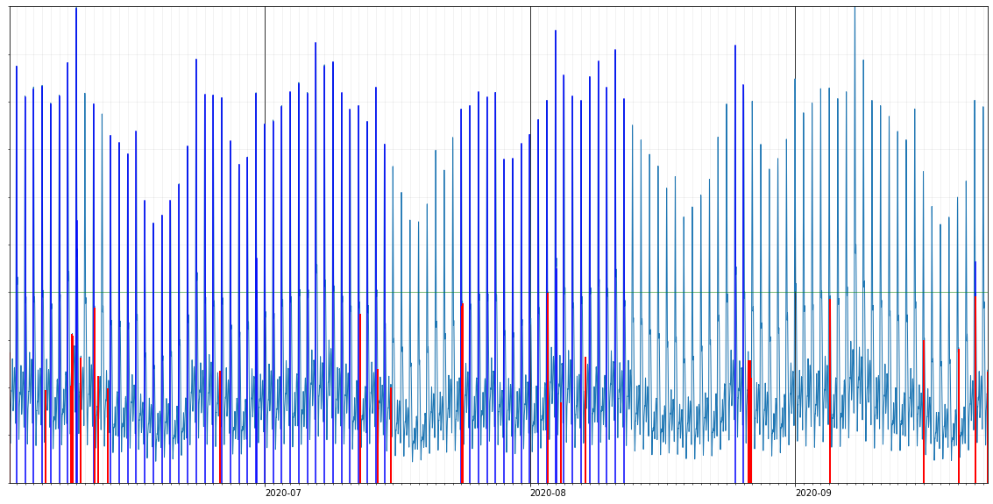
Finding unlikely (anomalous) events
Unlikely events:
2020-06-01 04:01:02
2020-06-05 10:05:44
2020-06-08 08:22:21
2020-06-08 10:00:04
2020-06-08 12:06:05
2020-06-08 12:39:18
2020-06-09 12:34:15
2020-06-11 02:47:58
2020-06-11 12:19:49
2020-06-12 16:42:32
2020-06-25 18:07:18
2020-07-12 03:07:51
2020-07-14 04:35:44
2020-07-15 16:57:23
2020-07-24 01:59:08
2020-07-24 02:46:08
2020-08-03 02:48:35
2020-08-04 15:01:51
2020-08-07 12:16:23
2020-08-26 13:00:17
2020-08-26 18:07:45
2020-08-26 19:22:36
2020-09-05 02:49:29
2020-09-16 02:03:23
2020-09-20 02:07:04
2020-09-22 02:54:00
2020-09-23 11:32:01

